Slide 1
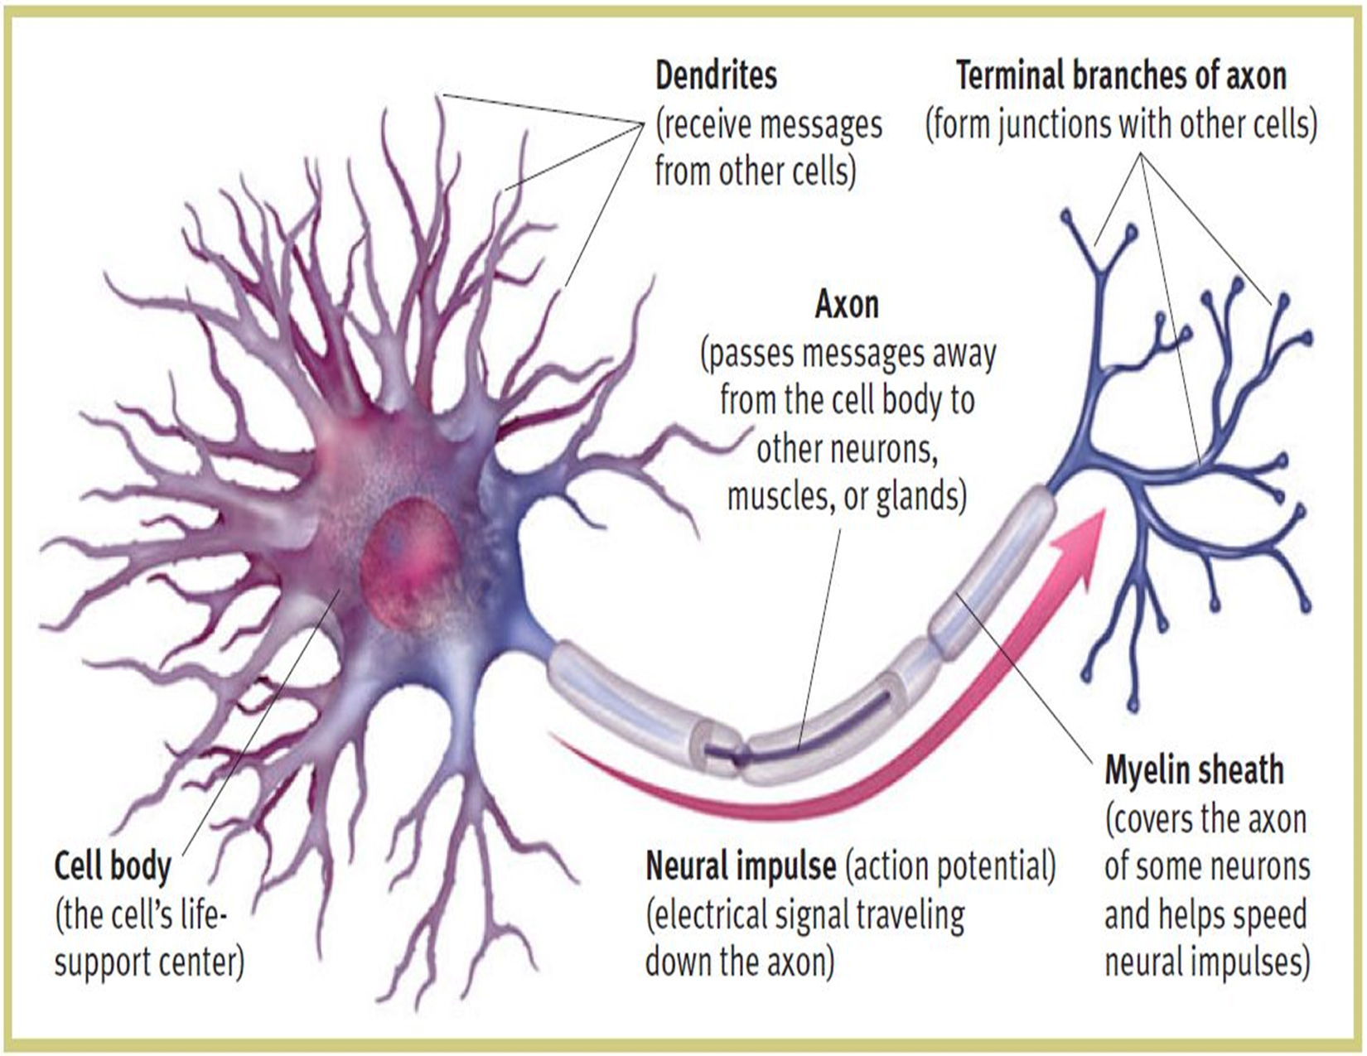
NEURON

Slide 2
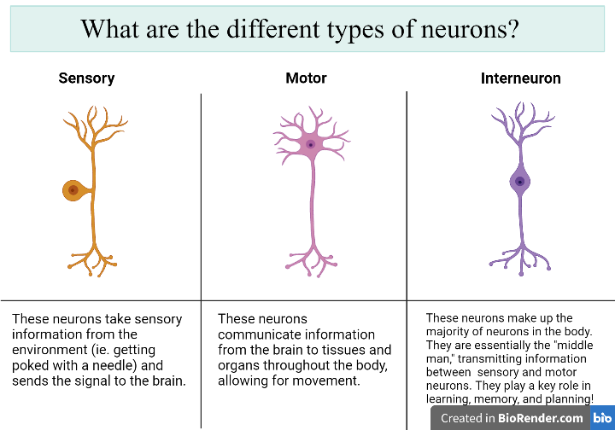

Slide 3
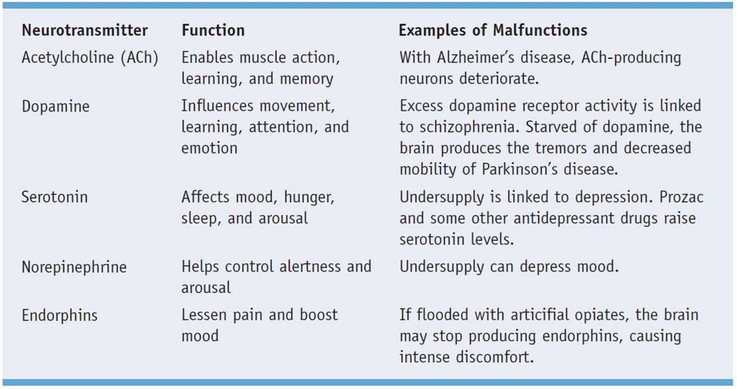

Slide 4
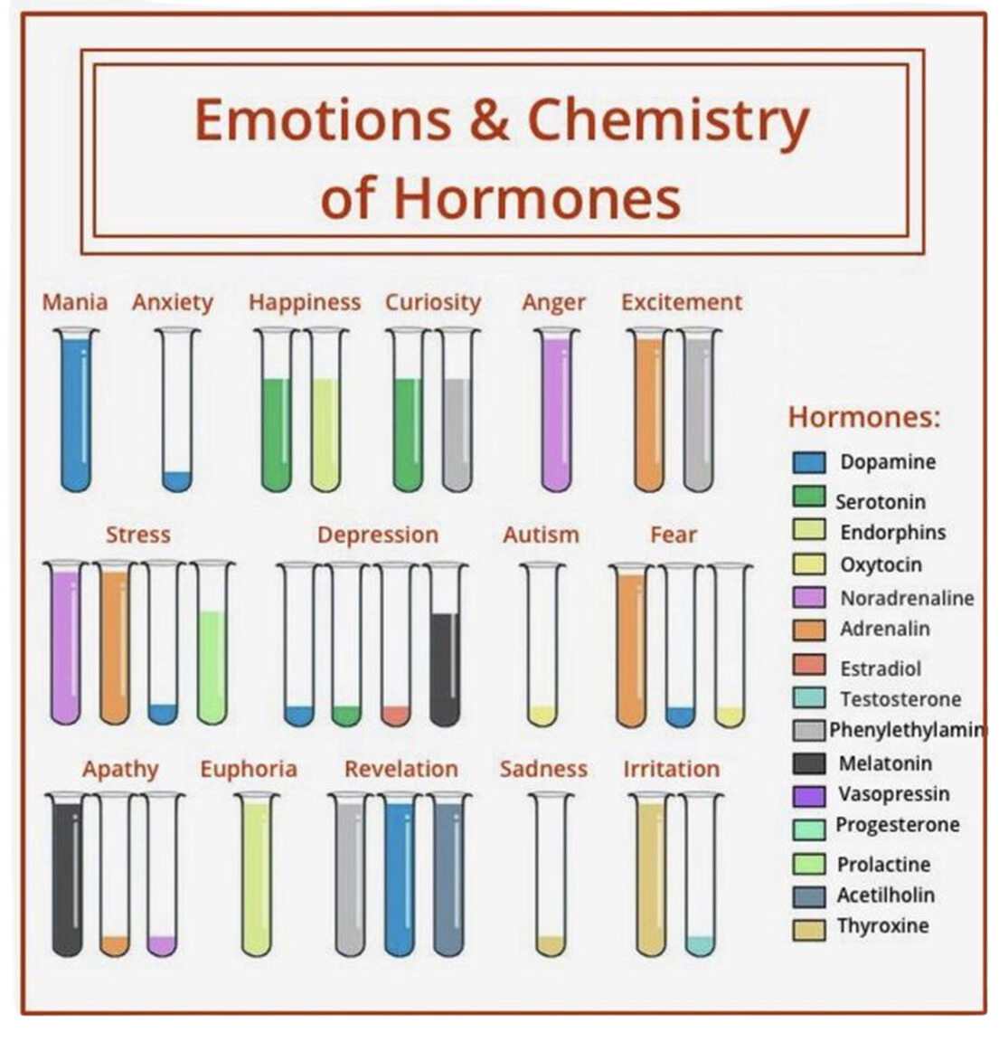

Slide 5
THE NERVOUS SYSTEM
The central command store of our body.
Thoughts, memory, learning, and feelings.
Movements, such as balance and coordination.
Senses, including how your brain interprets what you see, hear, taste, touch and feel.
Sleep, healing and aging.
Heartbeat and breathing patterns.
Response to stressful situations.
Digestion, as well as how hungry and thirsty you feel.
Body processes, such as puberty.

Slide 6
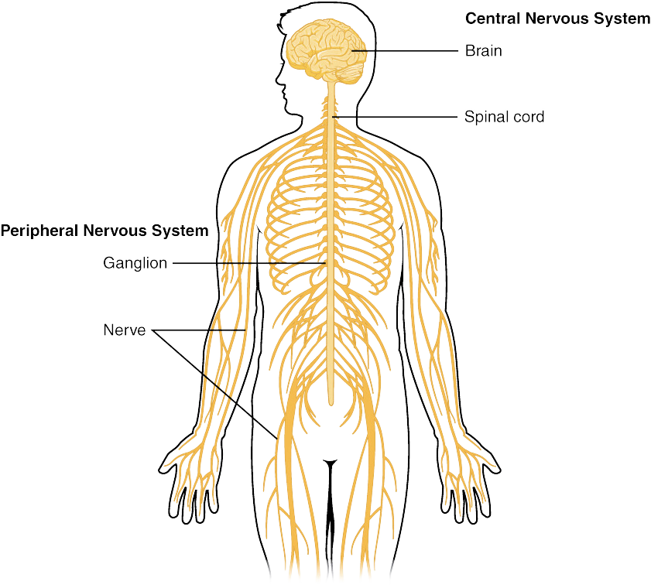

Slide 7
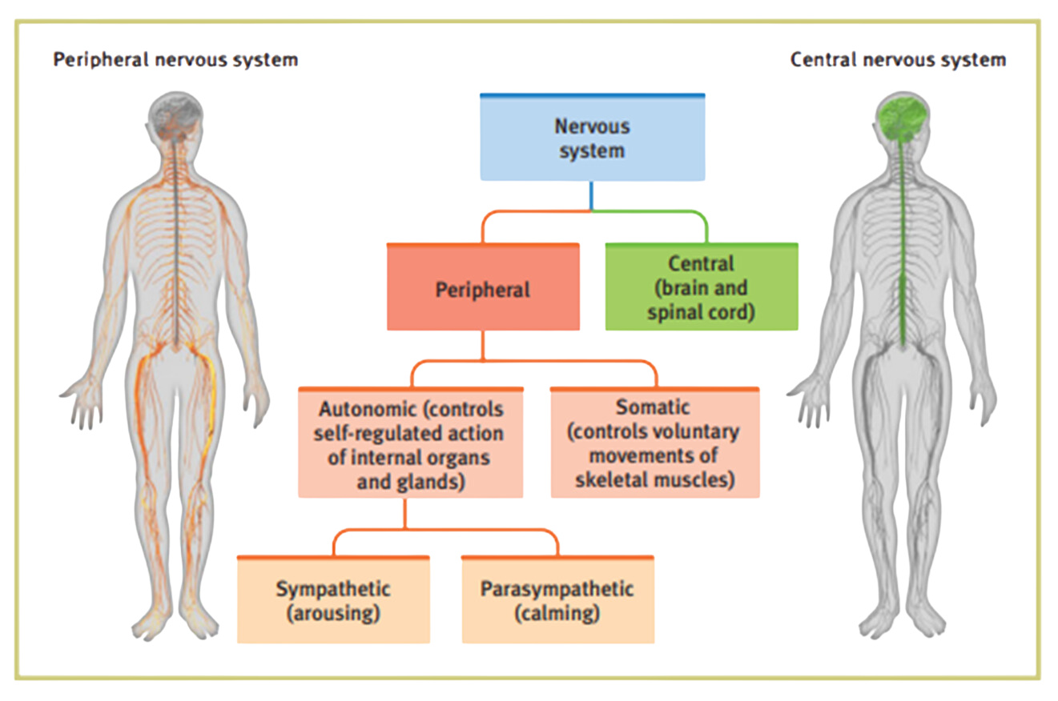

Slide 8
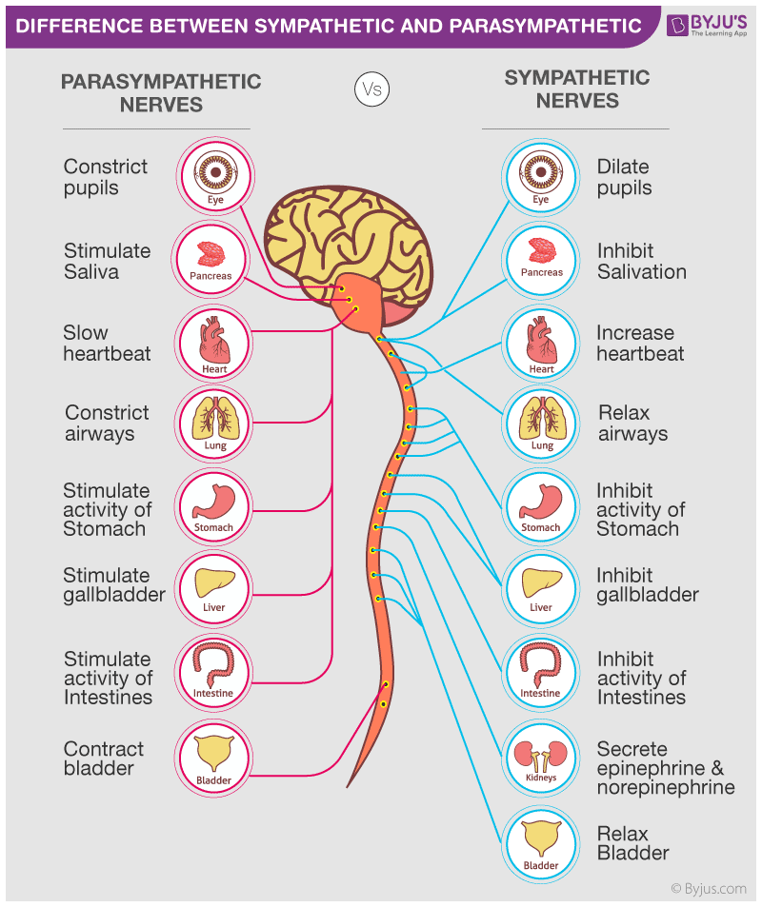

Slide 9
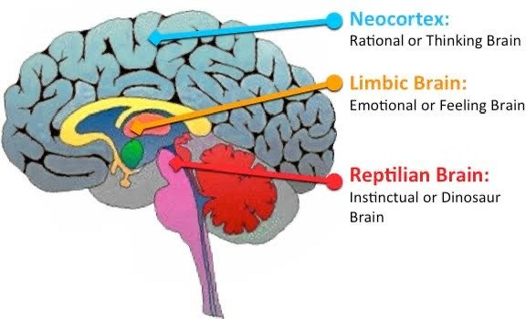

Slide 10
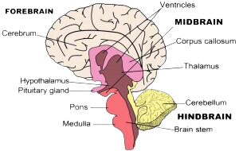
THE ORGANIZATION OF BRAIN
CEREBRAL CORTEX
LIMBIC SYSTEM
THE BRAINSTEM

Slide 11
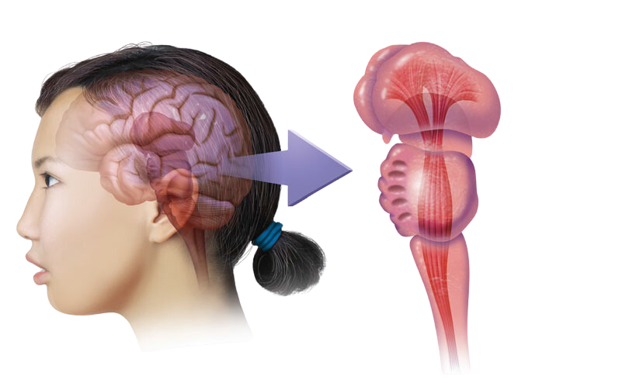
THE BRAIN STEM
THALAMUS
RETICULAR FORMATION
PONS
BRAIN STEM
MEDULA

Slide 12
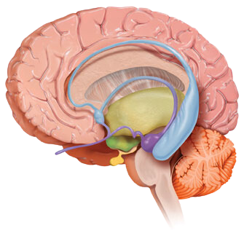
THE LIMBIC SYSTEM
THALAMUS
PITUITARY GLAND
AMYGDALA
HIPPOCAMPUS
THALAMUS
PITUITARY GLAND
AMYGDALA
HIPPOCAMPUS

Slide 13
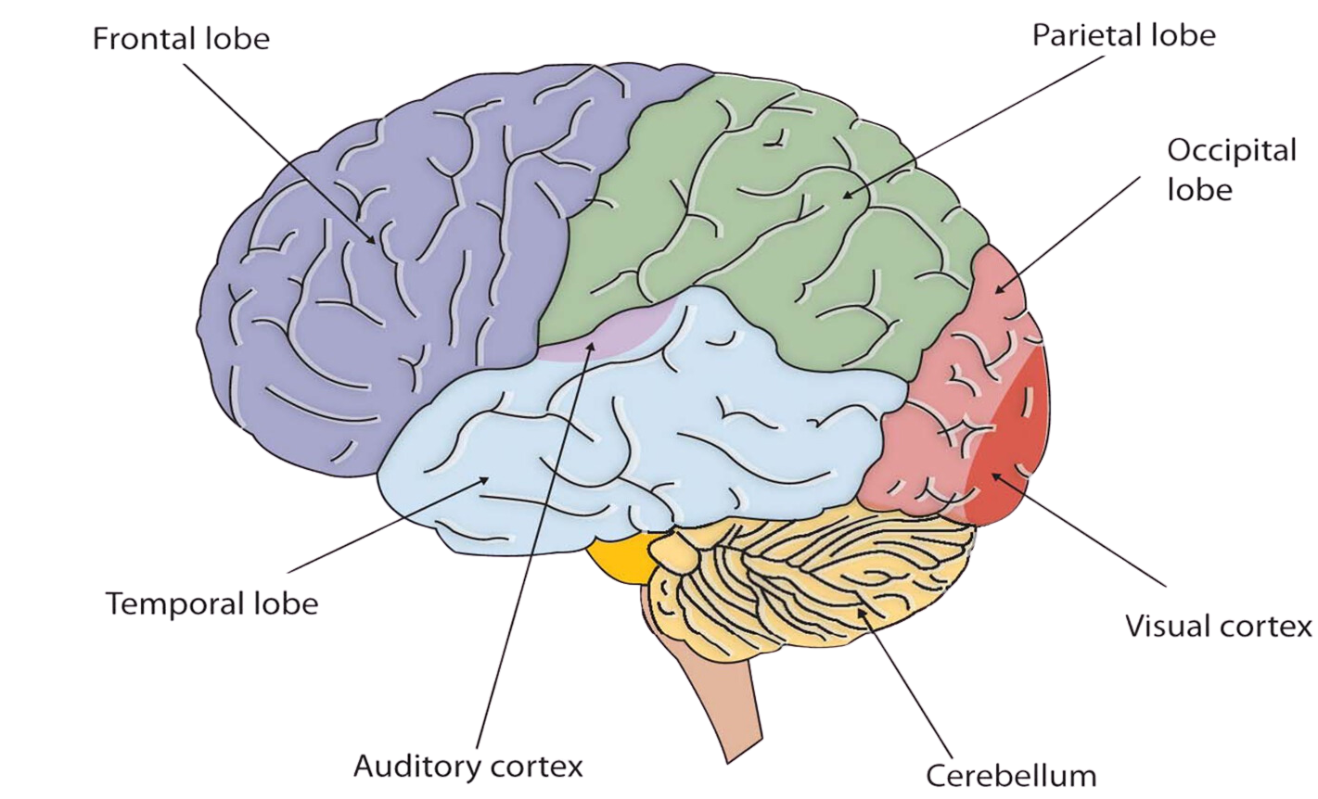
THE CORTEX

Slide 14
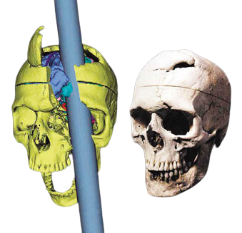
PHINEAS GAGE
One afternoon in 1848, Gage, then 25 years old, was packing gunpowder into a rock with a tamping iron. A spark ignited the gunpowder, shooting the rod up through his left cheek and out the top of his skull, leaving his frontal lobes massively damaged. To everyone’s amazement, he was immediately able to sit up and speak, and after the wound healed he returned to work. But the affable, soft -spoken Phineas Gage was now irritable, profane, and dishonest. Although his mental abilities and memories were intact, his personality was not. This person, said his friends, was “no longer Gage.” He eventually lost his job and ended up earning his living as a fairground exhibit.

Slide 15
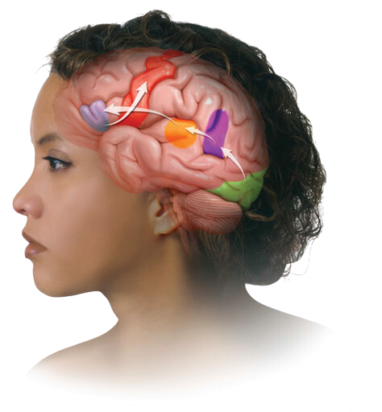
Aphasia, an impaired use of language, can result from damage to any one of several cortical areas.
In 1865, French physician Paul Broca reported that after damage to a specific area of the left frontal lobe (later called Broca’s area) a person would struggle to speak words while still being able to sing familiar songs and comprehend speech. Damage to Broca’s area disrupts speaking.
In 1874, German investigator Carl Wernicke discovered that after damage to a specific area of the left temporal lobe (Wernicke’s area) people could speak only meaningless words. Asked to describe a picture that showed two boys stealing cookies behind a woman’s back, one patient responded: “Mother is away her working her work to get her better, but when she’s looking the two boys looking the other part. She’s working another time” (Geschwind, 1979). Damage to Wernicke’s area also disrupts understanding.
A third brain area, the angular gyrus, is involved in reading aloud. It receives visual information from the visual area and records it into an auditory form, which Wernicke’s area uses to derive its meaning. Damage to the angular gyrus leaves a person able to speak and understand, but unable to read.
MOTOR CORTEX
(word is pronounced)
BROCA’S AREA
(controls speech
muscles via
the motor cortex)
ANGULAR GYRUS
(transforms visual
representations into
an auditory code)
WERNICKE’S AREA
(interprets auditory code)
VISUAL CORTEX
(receives written words
as visual stimulation)

Slide 16
How do you approach problem-solving?
I rely on intuition
I break the problem down into smaller steps and use logic.
How do you process information better?
Through images, patterns, and stories.
Through numbers, facts, and clear sequences.
When learning something new, do you prefer hands-on experience or reading detailed instructions?
I prefer hands-on experience and experimenting.
I prefer reading instructions or following a clear guide.
In your free time, what type of activities do you enjoy most?
Creative hobbies, such as painting, writing, or playing music.
Analytical activities like puzzles, math, or strategy games.

Slide 17
